Slide 1
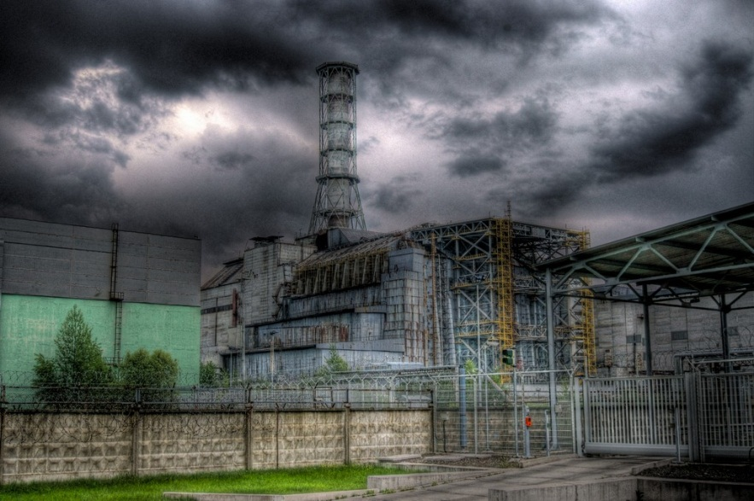
The Chernobyl Disaster
By:
M. Mikschl
P. Jörg
S. Demirev
T. Fink
T. Vassileva

Slide 2
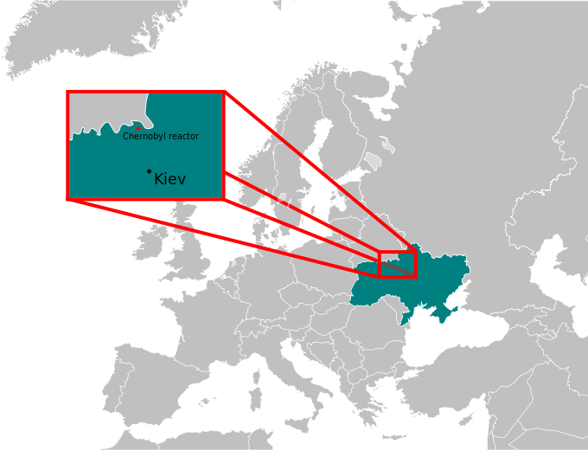
The Chernobyl Nuclear Disaster
Saturday, 26 April 1986:
The accident at reactor 4 occurred during an experiment to test a potential safety emergency core cooling feature.
2 workers died on the night of the accident
28 people died within a few weeks
Radiation injuries to over a hundred
115,000 people evacuated
220,000 people relocated
6,000 cases of thyroid cancer
Large areas were contaminated

Slide 3
Crisis Management
Immediate Reaction by the Soviet Government
Radiation levels on site exceeded dosimeters’ limits -> Assumption of intact reactor
All fires were extinguished 5 hours after the accident; most involved firefighters perished later on
Evacuation of Pripyat started only 36 hours after the accident. The town was evacuated within 3 hours, using 1100 buses
The government only admitted the accident after high radiation levels were measured in Sweden
Further development in 1986
The government tried to hush up the extent of the disaster, admitting 30 people had died
600,000 liquidators shoveled most of the debris inside the reactor
A sarcophagus was erected around the reactor by December 1986
Blocks 2 and 1 of the power plant were restarted in October

Slide 4
Relief Operation Pros and Cons
Irrational implementation of the immediate operations
Firemen, unaware of that they were fighting, local defense militia was called in to clean nuclear fuel from the roof (90sec. = disability pension and cash bonus). -
The logical thing was to bury the fire and the tons of radionuclides that remained in the ruins of the reactor. +
Helicopters with sand, boron, to absorb neutrons, lead, to shield the radiation, and dolomite, which would break down into carbon dioxide and help smother the flames. +
The pilots and crews received radiation at a rate of several hundred rad per hour. -
Fear that the nuclear fuel would become too concentrated and set off a true atomic explosion, destroying the neighboring three reactors => nuclear fuel carried out by hand -
Radioactive emission started melting the floor. Danger for getting into contact with the suppression pool below the reactor, the water there would instantly vaporize and explode. The water was taken out. +

Slide 5
Relief Operation Pros and Cons Cont.
Errors during the Sarcophagus building:
No protective clothing or respirators for the workers and had no shower facilities where they could wash the radionuclides from their bodies.
Most of the soldiers were later transferred to points throughout the Soviet Union
No accurate number of soldiers participated in the operations is available
An unhealthy environment: burning of radioactive objects (clothes, trees, pets, etc.)
Information deficiency: manipulated to hide health problems, solders were dislocated to different parts of the soviet union, lack of info for the population and that of the countries that might have been affected
Evacuation – everybody left their houses waiting outside to be evacuated under an invisible shower of isotopes

Slide 6
Past 27 years
Chernobyl Humanitarian Assistance and Rehabilitation Programme (CHARP)
Program running since 1990 by International Federation of Red Cross and Red Crescent Societies with local societies
address basic health needs of those living in the regions of the 3 countries affected (Belarus, Russia, Ukraine)
core activity is cancer screening, provide psychosocial support, distribute multivitamins to children living in radiation contaminated areas
Chernobyl Recovery and Development Programme (CRDP)
developed by the United Nations Development Program, initiated 2002
Aim: → return to normal life by providing support to the government of Ukraine for elaboration and implementation of development-oriented solutions for the regions
→ mitigate long-term social, economic and environmental consequences
→ create more favorable living conditions and to promote sustainable human development in affected regions
International Atomic Energy Agency (IAEA)
employs a safeguards system which is among the most advanced at any safeguarded nuclear facility
remote monitoring, on-site inspections, seals to ensure the non-diversion of nuclear material

Slide 7
Lessons Learnt
Chernobyl a stepping stone for a new philosophy – new term in nuclear energy “safety culture”
Nuclear power plants (NPPs) as units of national importance
Safety first! Priority given to people’s safety and preservation of the environment rather than productivity
Overhaul of current and future projects with focus on risk minimization
Emergency preparedness and safety measures
Understand, respect and minimize risk
International and national emergency response systems, highly involving the community
Adequate radiation measuring technology in place
NPP community for knowledge exchange (WANO) and international scientific co-operation
Constant quality and safety control and measurement
Continuous improvement of technology and safety measures
Communication is key!

Slide 8
References
UNSCEAR; “The Chernobyl Incident”; Available at: http://www.unscear.org/unscear/en/chernobyl.html
World Nuclear Association; “Chernobyl Accident 1986”; Available at: http://www.world-nuclear.org/info/Safety-and-Security/Safety-of-Plants/Chernobyl-Accident/#.UUR3xRzEOWI
International Federation of Red Cross and Red Crescent Societies (2011). Revised Plan 2011
- Chernobyl Humanitarian Assistance and Rehabilitation Programme (CHARP). Available at:
http://www.ifrc.org/docs/Appeals/annual11/MAA6700211p.pdf
International Federation of Red Cross and Red Crescent Societies (2011). Annual
Report Chernobyl Humanitarian Assistance and Rehabilitation Programme - Belarus,
Ukraine, Russia. Available at: http://reliefweb.int/sites/reliefweb.int/files/resources/
MAA6700211ar.pdf
United Nations Development Program (2008). UN to continue Chernobyl recovery efforts
until 2016. Available at: http://content.undp.org/go/newsroom/2008/april/un-to-continue-
chernobyl-recovery-efforts-until-2016.en
United Nations Development Program (2013). Chernobyl Recovery and Development
Programme. Available at: http://www.undp.org.ua/en/projects-list-all/37-local-
development-and-human-security-/614-chornobyl-recovery-and-development-programme
United Nations (2008). UN Action Plan on Chernobyl to 2016 - Final Version.
Available at: http://chernobyl.undp.org/russian/docs/UNActionPlan_revised.pdf
International Atomic Energy Agency (2012). Chernobyl - 25 years, 25 Stories.
Available at: http://www.iaea.org/newscenter/focus/chernobyl/25years/
OWT. Chernobyl Timeline. Available at: http://users.owt.com/smsrpm/Chernobyl/tline.html
TESEC. Lessons Learnt from Chernobyl. Available at: http://www.tesec-int.org/chernobyl/Lessons.htm
The Telegraph. Chernobyl anniversary: 5 lessons from the disaster. Available at: http://www.telegraph.co.uk/news/worldnews/europe/ukraine/8473439/Chernobyl-anniversary-5-lessons-from-the-disaster.html

Slide 9
Thank you for the attention!

